Slide 1
Survival Analysis I
Content originally prepared
by Joris Menten

Slide 2
Overview
Part I:
  What is survival data?
  Why do we need special statistical techniques?
  Summarizing survival data:
    Kaplan-Meier curves
  Comparing two survival curves:
    the logrank and Wilcoxon tests

Slide 3
When do we use survival analysis ?
Always when we are interested in the time from one event to another
  Start event (time of origin):
    start of treatment
    moment of infection
    time of exposure (to radiation, cigarette smoke, ...)
    birth
    ...

Slide 4
When do we use survival analysis ?
  End event (time of end point):
    death
    disease (myocardial infarction)
    treatment failure (elevated viral load in HIV)
    treatment success (pain relief)
    pregnancy
    ...
Survival analysis can be used for any “time-to-event" data

Slide 5
Example of study: time to treatment failure on ARV
Start ARV
Patient 1
Failed
Start ARV
Patient 2
Failed
Start ARV
Patient 3
Censored
Start ARV
Patient 4
Censored
Start ARV
Patient 5
? Failed or Censored ?
Start recruitment
End recruitment
End follow-Up
1-Jan-2006
1-Jul-2006
1-Apr-2007
Time

Slide 6
Survival trials
Some typical aspects of survival trials:
  Not all patients enter the study at the same time
  The study ends on a specific date
    pre-planned date
    more commonly: when a specific, preplanned number of events has been observed
  ⇒ follow-up time is different for each patient

Slide 7
Survival trials
  Not all patients will experience an event
    because study has stopped
    because patients are lost to follow-up
    ...
  But, our outcome is "time to event"
  ⇒ We do not have data for all patients:
    for some, we have the time of the event
    for some, we only know that the event has not yet occurred at a certain time
  ⇒ "censored" data

Slide 8
Survival trials
Difficult cases:
  Patients who die, if the outcome is not death but treatment failure or other morbidity
    death due to treatment or disease-related outcome
    ⇒ treatment failure
    death due to other causes
      How can you be sure ? E.g., car crash; but what if the drug causes drowsiness...
    ⇒ use treatment failure + all-cause death as primary endpoint

Slide 9
Survival trials
  Patients who discontinue treatment
    due to lack of efficacy
    ⇒ treatment failure
    due to side-effects
    ⇒ treatment failure
    due to other reasons
    ⇒ continue follow-up if possible
      include all follow-up data in "all patients included" or "intention to treat" analysis
      consider patients as censored at treatment discontinuation for "per-protocol" analysis
Note: Even if a patient does not come to the study site, you can collect some data (e.g., death/hospitalization from hospital records).

Slide 10
Assumptions for survival analysis
  At most 1 event per subject
  what with patients with more than 1 event:
    of the same type (recurrent events)
    of different types (first virological treatment failure, then opportunistic infections, then death)
  ⇒ record all events
  ⇒ for analysis: select first event of interest
    can be different events for different analyses of a trial:
    E.g.: trial of cardiac surgery, assess different outcomes:
    - primary endpoint: new cardiac event, cardiac procedure or death
    - secondary endpoint: cardiac procedure or death
    - tertiary endpoint: death

Slide 11
Assumptions for survival analysis
  Data are (possibly) right censored
  Right censoring:
    we know when an event has not yet occurred
    common: standard survival analysis
  Left censoring:
    we know that an event has occurred before a certain time, but not exactly when
    uncommon
  Interval censoring
    we know that an event occurred during a certain period
    common (e.g., viral load only measured at certain time points)

Slide 12
Assumptions for survival analysis
  Censoring is "uninformative"
  survival time is independent of censoring:
survival time of patients that are censored at a certain time point
=
survival time of patients that remain in the study
  often violated:
    drop-outs are too ill to return or are deceased
    censoring of patients when they switch to alternative therapies
    patients returning to the clinic may be more ill and seek medical attention

Slide 13
Analyzing survival data
Re-format the data
  use "patient time":
    time of origin (start treatment, exposure, ...) = 0
  indicate for all patients if they had the event or not (censored):
    0 = censored, 1 = event
  calculate time between time of origin and time of event or censoring

Slide 14
Re-format the data: use "patient time"
Patient 1
Failed
Patient 2
Failed
Patient 3
Censored
Patient 4
Censored
Patient 5
Failed
Start of ARV
6 months
12 months
Patient Time

Slide 15
Re-format the data
ID | Treatment | Event | Time (months)
1 | A | 1 | 10
2 | A | 1 | 7
3 | A | 0 | 12
4 | A | 0 | 10
5 | A | 1 | 9
6 | B | 0 | 10
7 | B | 0 | 11
8 | B | 0 | 12
9 | B | 0 | 6
10 | B | 1 | 8

Slide 16
Analysing survival data
Summarise the data:
  summary statistics: mean "survival time“?
    what do we do with censored patients?
      Delete?
      Survival time on treatment A:
      mean = 8.7 months median = 9 months
      Survival time on treatment B:
      mean = 8.0 months median = 8 months
    ?? So treatment A is better than B ??
    But: 3 out of 5 patients failed on treatment A, while only 1 out
    of 5 failed on treatment B
    And: we know at least 3 patients out of 5 on treatment B, had a time to failure of more than 10 months

Slide 17
Analysing survival data
⇒ Never calculate a simple mean/median "time to
event" for censored date using only those who
have the event!
  also for analyses that do not appear to be "survival data"
    e.g.: household survey of 15 - 25 year olds: "age married"
    laboratory data above detection limit

Slide 18
Analysing survival data
  summary statistics: proportion that failed at a certain time?
    % failed by month 12:
    Treatment A: 3/5 = 60%
    Treatment B: 1/5 = 20%
    Problems:
    data reduction: you lose information
    ⇒ loss of "power" to detect treatment differences
    censored data: not all patients are in follow-up for the full 12 months

Slide 19
Analysing survival data
  summary graph: Kaplan-Meier curve
    shows probability of surviving to a certain time point
    mathematically:
      t is actual survival time of an individual
      t is a value of a "random variable" T (for all individuals)
survivor function = S(t) = P (T ≥ t)
        function: for every time t, we have a value
        probability: between 0 and 1
        T ≥ t: that (for any individual) the survival time is a large as (or larger than) the specific time t
      the survivor function S is estimated by the K-M curve
        "empirical" (or observed) survivor function

Slide 20
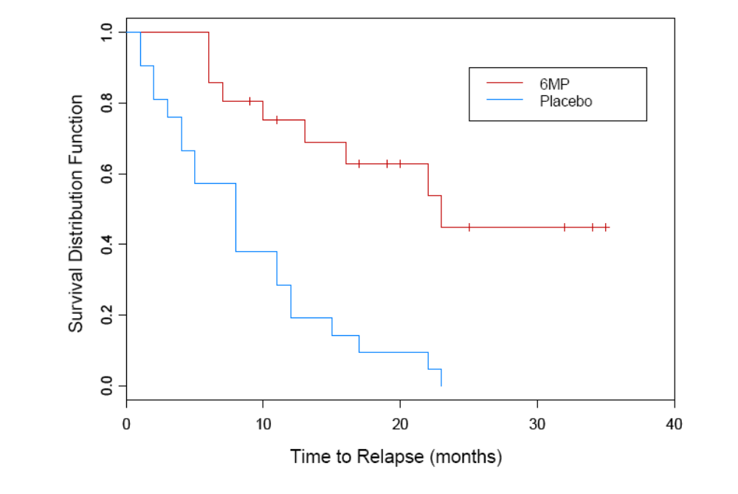
Study of 42 children with leukemia (1963) treated with placebo or 6MP

Slide 21
Death or
treatment failure
Censored

Slide 22
Survivor function for 6MP lies always above that for placebo
⇒ At any time, the probability of surviving
up to that time point (or longer) is higher on 6MP
⇒ 6MP is effective in delaying relapse/death

Slide 23
Interpretation of K-M curves: median survival time
Median survival time:
Placebo: 8 months
6MP: 23 months

Slide 24
Interpretation of K-M curves: survival rate at specific time point
One-year survival rate
Placebo: ~ 20%
6MP: ~ 75%

Slide 25
"True" survivor function is not in steps,
but is a smooth curve.
K-M curve is an estimator
of the survivor function.

Slide 26

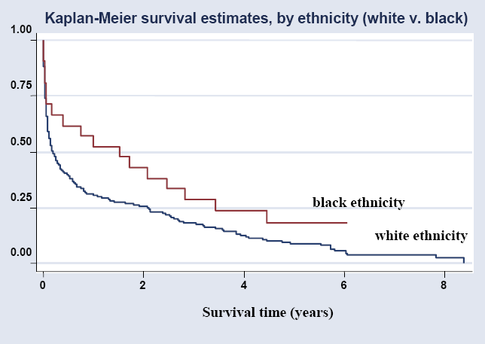
Survival after stroke in south London (UK)
(Wolfe et al., BMJ Aug 2005)

Slide 27
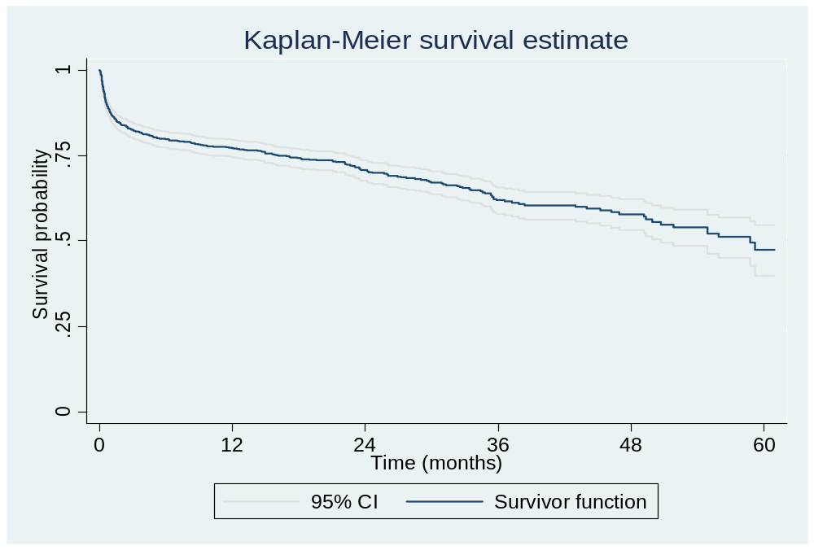
Survival function with 95% confidence bands

Slide 28
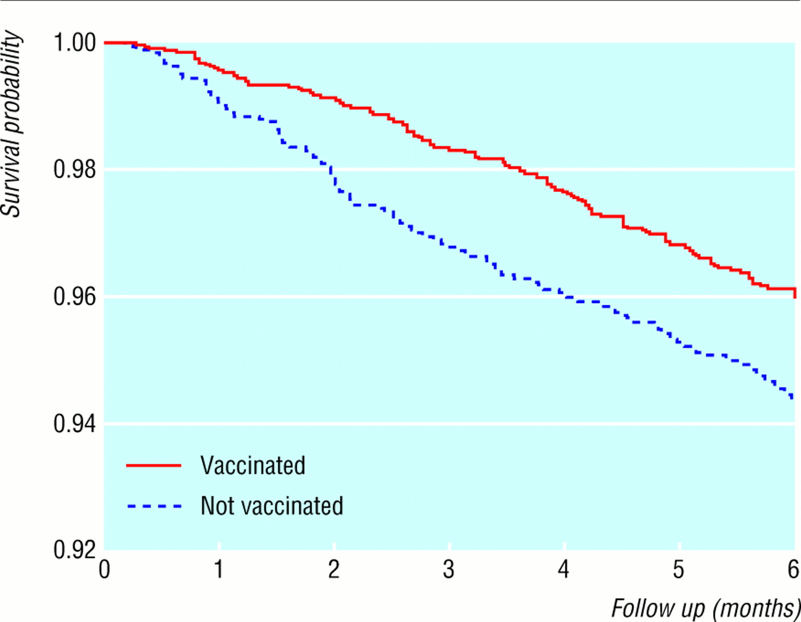

Kaplan-Meier survival curves for children
who did and did not receive BCG vaccine.
Median survival
time ?
Kristensen, I. et al. BMJ 2000;321:1435
Copyright ©2000 BMJ Publishing Group Ltd.

Slide 29
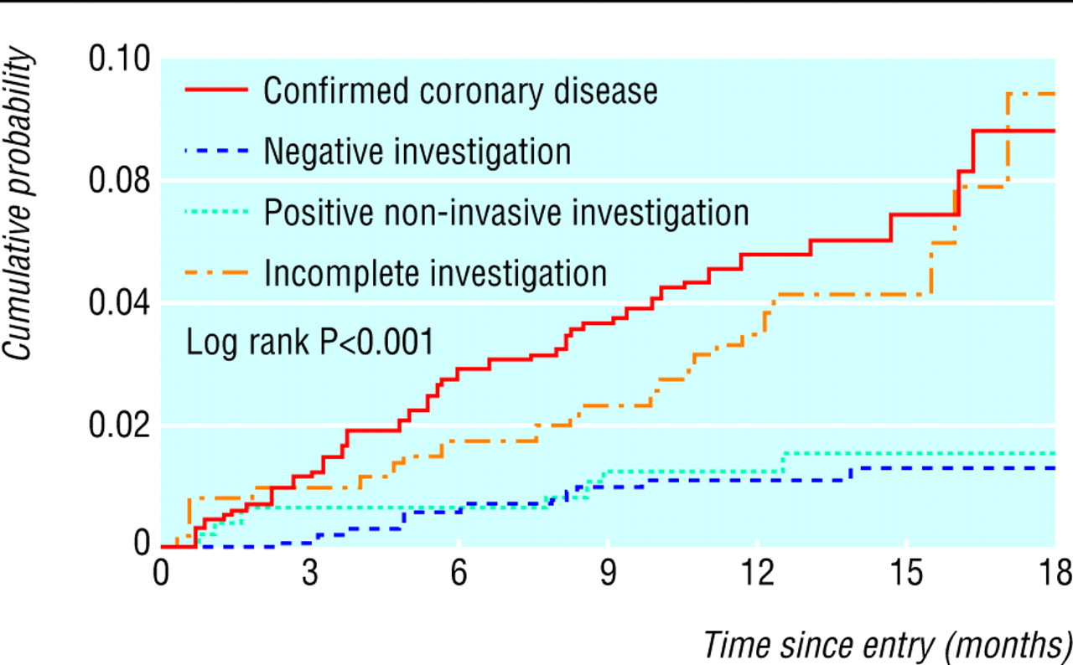
Fig 1 Cumulative probability of death or non-fatal myocardial infarction during follow-up in patients with stable angina, according to diagnostic level of confirmation of coronary disease
Daly, C. A et al. BMJ 2006;332:262-267
Copyright ©2006 BMJ Publishing Group Ltd.

Slide 30
Kaplan-Meier curves
survivor function is descending
  sometimes people plot F(t) = 1 - S (t)
survivor function is a smooth curve, but K-M curve is an approximation
  using observed data
  stepped appearance: bigger steps if few subjects
  K-M curve is a "non-parametric" procedure
  for smooth curves: "parametric" procedures
    assumes a certain form of S(t) (exponentional, ...)
      estimate characteristics (parameters) of this survivor curve
    less used, but important for sample size calculations

Slide 31
Kaplan-Meier curves
K-M curve allows estimation of
  median survival time (also quartiles etc.)
  probability of survival to a certain time point
  ! if curve includes the relevant point
    no extrapolation
    median survival time can only be estimated if 50% of subjects died
    only in steps (discrete)
    versus parametric methods: smooth and allow extrapolation

Slide 32
Comparing survival curves
Compare survival curves
  visually:
    if you cannot see an effect, it is not there
    ALWAYS make graphs first
    of ALL the effects you plan to test
      also if there are a lot of effects ...
      in observational studies: think about possible confounders
  test:
    Logrank and Wilcoxon test
    Cox regression

Slide 33
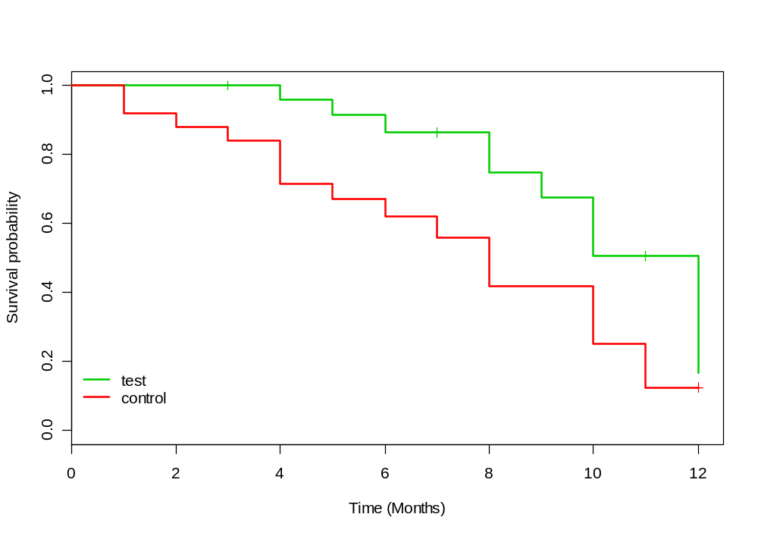
Comparing survival curves
Cancer clinical trial of new chemotherapy vs. standard therapy
Endpoint: death or cancer recurrence
Does the new therapy work ?

Slide 34
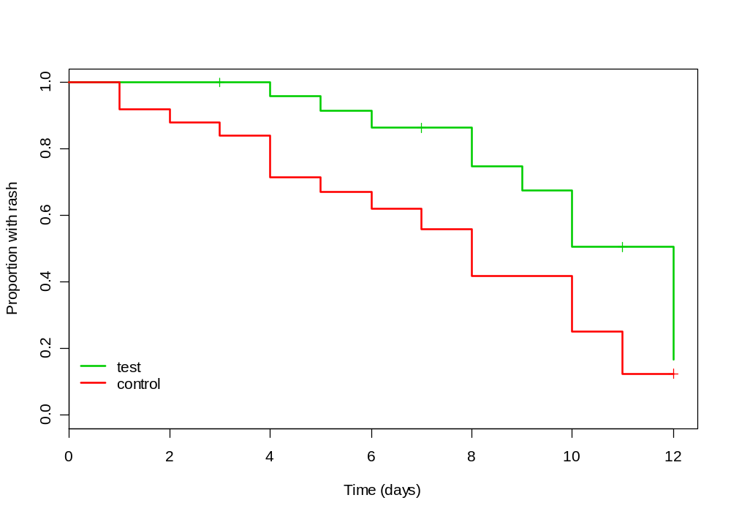
Comparing survival curves
Clinical trial of new medication (versus standard therapy) to treat a rash
Endpoint: time to disappearance of symptoms
Does the new therapy work?

Slide 35
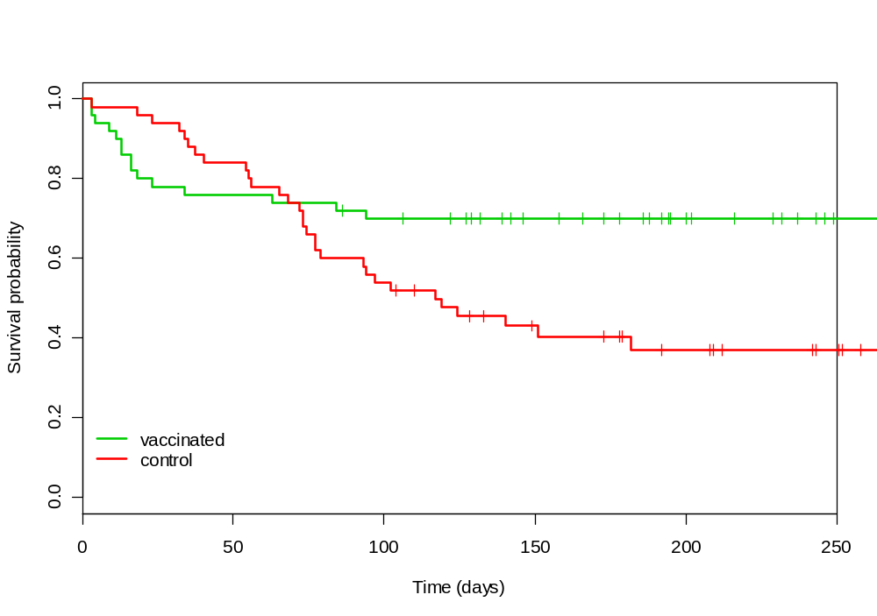
Comparing survival curves
Clinical trial of vaccine for influenza
Endpoint: onset of fever episode. How do you interpret this graph ?

Slide 36
Comparing survival curves
Test comparing two survival curves
  Logrank
    most used, recommended
    most appropriate if the treatment effect is constant over time
  (Gehan-) Wilcoxon test
    more powerful for early differences
    less used
  Usually give the same result

Slide 37
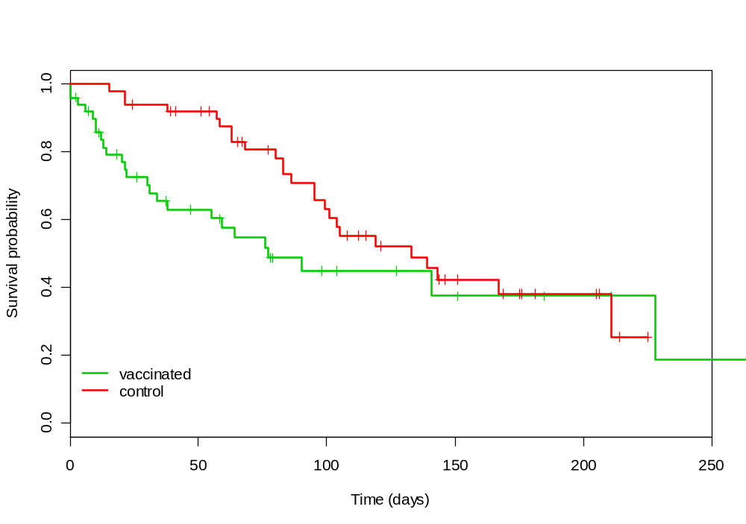
Comparing survival curves
Logrank test: p-value = 0.075
Wilcoxon test: p-value = 0.011

Slide 38
Drawing Kaplan-Meier curves
Dataset from Bland & Altman, BMJ 2004
Population: 51 adults with recurrent gliomas
Variables in dataset:
Event: patient died (1) or was censored (0)
Time: weeks to death or censoring
Group: astrocytoma or glioblastoma
Patient ID

Slide 39
Survival Analysis in R
Install (if needed) and load package for survival analysis
install.packages("survival")
library(survival)

Slide 40
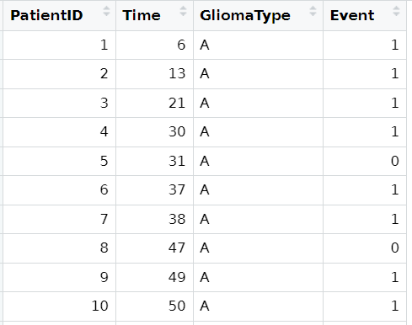
Variables in the dataset

Slide 41
K-M for whole study population
mod <- survfit(Surv(Time, Event) ~ 1, data=dat)
Surv(Time, Event) : The “outcome variable” now consists of two variables, the time and the event
~ 1 : No other variables (for now), so K-M for whole population
To make the plot:
plot(mod, mark.time = TRUE)
mark.time = TRUE : Marks censored cases with a +

Slide 42
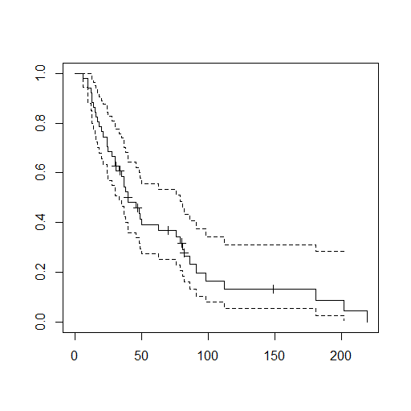
1 K-M survival curve with
95% confidence bands
Median survival time?

Slide 43
Output
> mod
Call: survfit(formula = Surv(Time, Event) ~ 1, data = dat)
n events median 0.95LCL 0.95UCL
51 42 40 33 79
> summary(mod)
Call: survfit(formula = Surv(Time, Event) ~ 1, data = dat)
time n.risk n.event survival std.err lower 95% CI upper 95% CI
6 51 1 0.9804 0.0194 0.94307 1.000
10 50 2 0.9412 0.0329 0.87877 1.000
12 48 1 0.9216 0.0376 0.85066 0.998
13 47 2 0.8824 0.0451 0.79821 0.975
14 45 1 0.8627 0.0482 0.77329 0.963
15 44 1 0.8431 0.0509 0.74901 0.949
16 43 1 0.8235 0.0534 0.72528 0.935
...

Slide 44
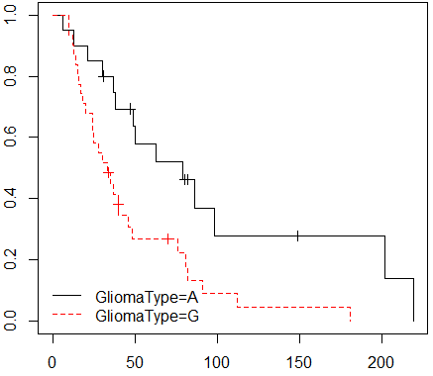
K-M curve per group
mod <- survfit(Surv(Time, Event) ~ GliomaType, data=dat)
plot(mod, mark.time=TRUE)
2 K-M survival curves
Median survival times?

Slide 45
Compare 2 K-M curves
Log-rank test
> survdiff(Surv(Time, Event) ~ GliomaType, data=dat)
Call:
survdiff(formula = Surv(Time, Event) ~ GliomaType, data = dat)
N Observed Expected (O-E)^2/E (O-E)^2/V
GliomaType=A 20 14 22.5 3.20 7.5
GliomaType=G 31 28 19.5 3.69 7.5
Chisq= 7.5 on 1 degrees of freedom, p= 0.006

Slide 46
Compare 2 K-M curves
Wilcoxon test
> survdiff(Surv(Time, Event) ~ GliomaType, rho=1, data=dat)
Call:
survdiff(formula = Surv(Time, Event) ~ GliomaType, data = dat, rho = 1)
N Observed Expected (O-E)^2/E (O-E)^2/V
GliomaType=A 20 6.67 11.7 2.16 6.13
GliomaType=G 31 17.69 12.7 2.00 6.13
Chisq= 6.1 on 1 degrees of freedom, p= 0.01

